Slide 1
SQL Subquery

Slide 2
What is SQL Sub query?
A sub query is a SQL query nested inside a larger query.

Slide 3
Where Sub query occurs?
A subquery may occurs in:
A SELECT clause
A WHERE clause
The sub query can be nested inside a SELECT, INSERT, UPDATE, or DELETE statement or inside another sub query.
A sub query is usually added within the WHERE clause of another SQL SELECT statement.
You can use the comparison operators, such as >, <, or =. The comparison operator can also be a multiple-row operator, such as IN, ANY, or ALL.

Slide 4
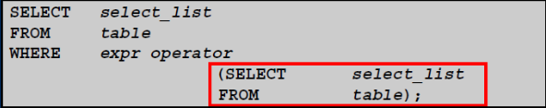
SUBQUERY SYNTAX
The subquery (inner query) executes before the main query(outer query).
The result of the subquery is used by the main query.

Slide 5
TYPE OF SUBQUERIES
Single row subquery : Returns zero or one row.
Multiple row subquery : Returns one or more rows.
Multiple column subqueries : Returns one or more columns.

Slide 6
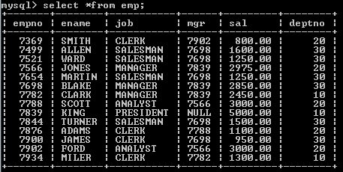
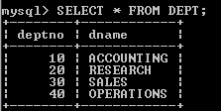
SINGLE ROW SUBQUERIES
The single row subquery returns one row. The single row query uses any operator in the query i.e. (=,<=, >=, <>, <, > ).
EXAMPLE:
department table
Employee table

Slide 7

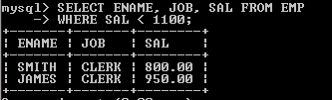
Suppose you want to find out the ename, job,sal of the employees whose salaries are less than that of an employee whose empno= 7876 from EMP table. Now you need to perform two queries in order to get the desired result.
We will find out the salary of the employee whose empno=7876. the query is as under:
Now in second query we will apply the condition from which we will find the ename, job and sal. We will use the query as under:

Slide 8
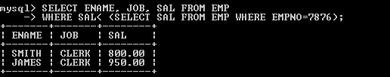
The above two queries can be used as single query by using the concept of subquery. It will combine the result into a single query as under:

Slide 9
MULTIPLE ROW SUBQUERY
Returns sets of rows. Query uses the set comparison operators (IN, ALL, ANY). if u use a multirow subquery with the equals comparison operators, the database will return an error if more than one row is returned.
SYMBOL | MEANING
IN | Equal to any member in a list.
ANY | Return rows that match any value on a list.
ALL | Return rows that match all the values in a list.

Slide 10
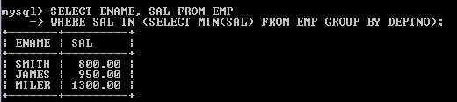
IN Operator
The IN operator retirns true if the comparison value is contained in the list.
The following statement finds the employee whose salary is the same as the minimum salary of the employees in the department.

Slide 11
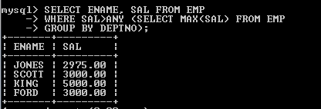
ANY Operator
The ANY operator return true if the comparison value matches any of the values in the list.
Display the employees whose salary is more than the minimum salary of the employees in any department.

Slide 12
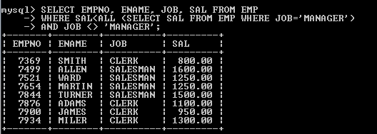
ALL Operator
Returns true only if the comparison value matches all the values in the list.
Display the employee detail with salary less than those whose job is ‘MANAGER’.

Slide 13
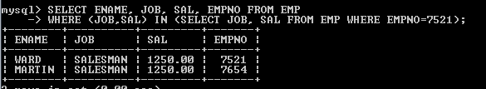
MULTIPLE COLUMN SUBQUERY
A subquery that compares more than one column between the parent query and subquery is called the multiple column subqueries.
List the employees that makes the same salary as other employee with empno=7521 with the same job also.

Slide 14

Deleting Tables
One can delete from a table by using DELETE FROM statement. The DELETE statement removes rows from a table, but it does not release storage space.
SYNTAX:
DELETE FROM table_name;
Example: To remove all rows in the student table, you just execute the following query: DELETE FROM student;

Slide 15


